Slide 1
Physical Chemistry
Ying Hu
(Fifth edition)
Bilingual Program
版权所有：华东理工大学物理化学教研室

Slide 2
Part V Extension
Chapter 17
Electrochemistry
Bilingual Program
版权所有：华东理工大学物理化学教研室

Slide 3
16. Electrolyte Solutions
I. Electrochemical Equilibria
    17.2 Electromotive Force of Galvanic Cell and Interfacial
    Potential Difference
    17.3 Thermodynamics of Electrochemical Systems
    17.4 Potential and Standard Potential of Cell Reaction
    17.5 Potential and Standard Potential of Electrode Reaction
    17.6 Various Types of Electrodes and Standard Cell
    17.7 Electrochemical-Equilibrium Calculations
    17.8 Concentration Cell and Liquid-Junction Potential

Slide 4
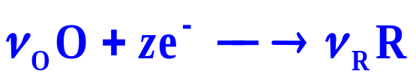
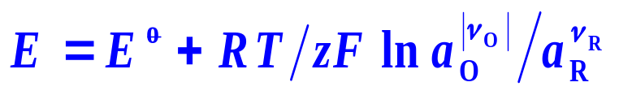
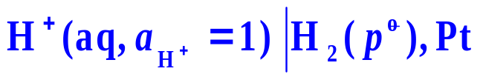
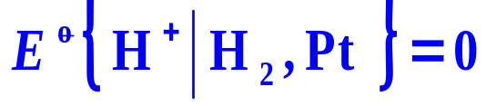
Electrode： Solution│Electrode
Electrode reaction：
Nernst Equation:
Standard Hydrogen Electrode (SHE)
Various Types of Electrodes
1. Metal-Metal Ion Electrodes
2. Metal Amalgam-Metal Ion Electrodes
3. Platinum-Nonmetal-Nonmetal Ion Electrodes
4. Oxidation-Reduction Electrodes
5. Metal-Sparingly Soluble Salt-Anion of the Salt Electrodes
6. Ion-Selective Electrodes

Slide 5
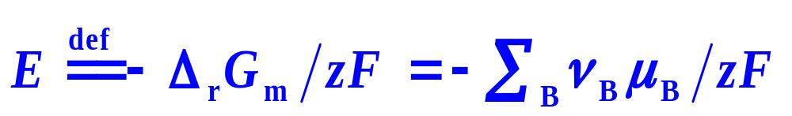

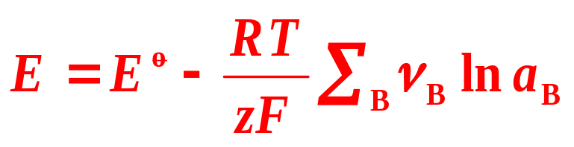
17.4 Potential and Standard Potential of Cell Reaction
1. Basic Calculations for Potentials of Cell Reaction and Potentials of Electrode Reaction
Potential of Cell Reaction
E – intensive property
ΔrGm – extensive property
Nernst Equation

Slide 6
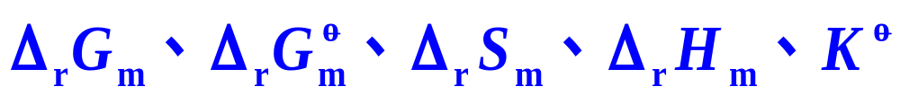
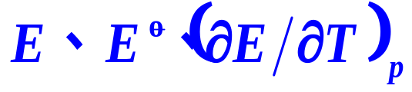
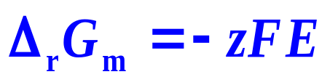
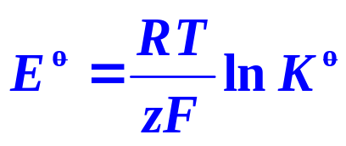
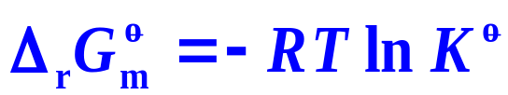

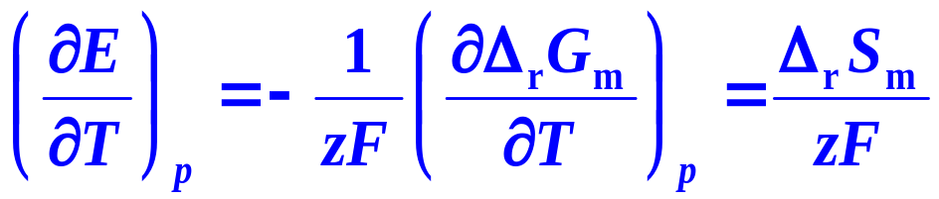
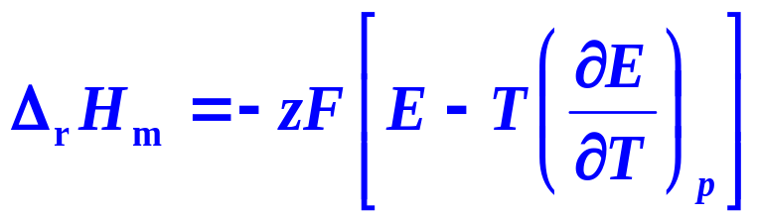
17.7 Electrochemical-Equilibrium Calculations
2. Calculations of Thermodynamic Functions and Standard Equilibrium Constant of Chemical Reactions
Judge the direction of the reaction

Slide 7
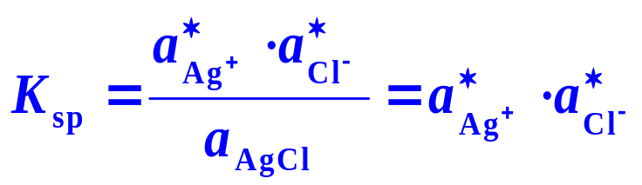
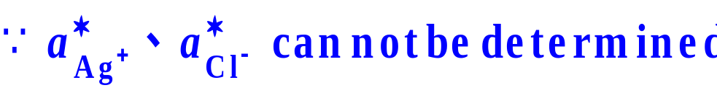




17.7 Electrochemical-Equilibrium Calculations
3. Calculations of Ionic Product of Water, Solubility Product of Sparingly Soluble Salts and Instability Constant of Complex Ions
K_{sp} of AgCl
If Ag⁺ and Cl⁻ are in the same bulk solution,
K _{sp} can not be calculated directly
Electrochemical method
Design a cell reaction as
Negative
Positive
Cell reaction
is the same as (1)

Slide 8
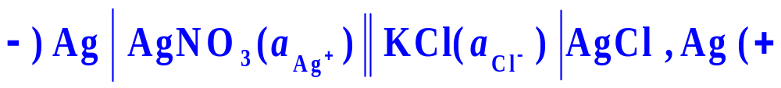
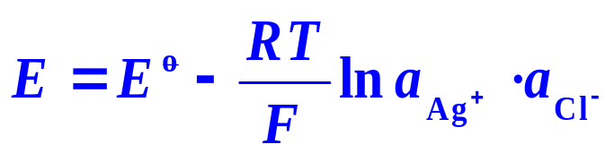
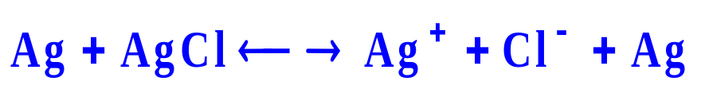


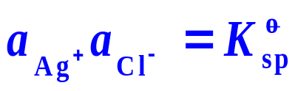
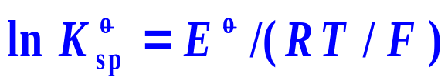
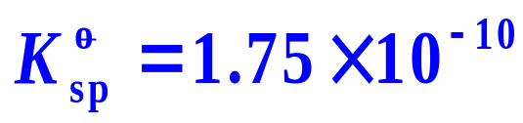
17.7 Electrochemical-Equilibrium Calculations
Design the cell with cations and anions as electrolytes participating in the electrode reaction
At equilibrium

Slide 9

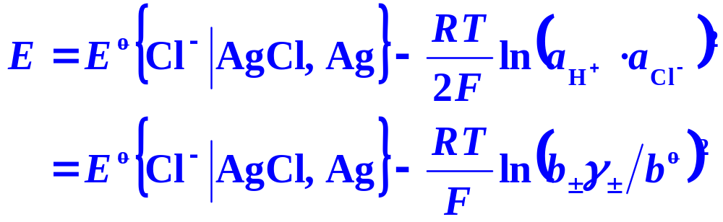
17.7 Electrochemical-Equilibrium Calculations
4. Calculations of Mean Ionic Activity Factors
1. Calculate the mean ionic activity factors of HCl solutions with different concentrations.
Solution:
Design a cell
Determining E, γ± at various concentrations b can be calculated.

Slide 10
17.7 Electrochemical-Equilibrium Calculations
4. Calculations of Mean Ionic Activity Factors
At 298.15K,
Pt|H₂( )|H₂SO₄(4mol.kg⁻¹)| Hg₂SO₄(s)|Hg(l)
the potential of cell reaction E is 0.6120V, the standard potential of the cell reaction is 0.6152.
Write down the electrode reactions and the cell reaction.
Calculate the mean activity coefficient of H₂SO₄ solution
.

Slide 11
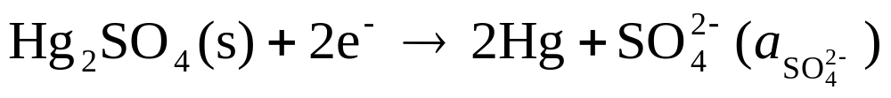
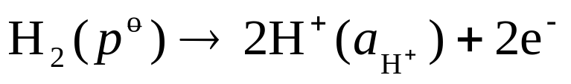
17.7 Electrochemical-Equilibrium Calculations
4. Calculations of Mean Ionic Activity Factors
Pt|H₂( )|H₂SO₄(4mol.kg⁻¹)| Hg₂SO₄(s)|Hg(l)
(1)The electrode reactions and the cell reaction.
Positive electrode
Negative electrode
Cell reaction

Slide 12
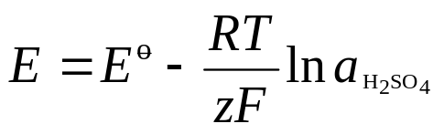
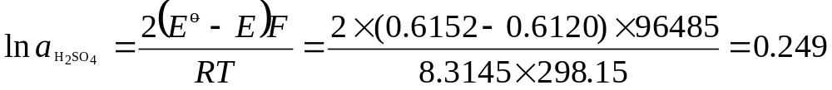

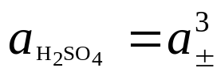
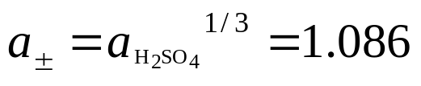
17.7 Electrochemical-Equilibrium Calculations
4. Calculations of Mean Ionic Activity Factors
Pt|H₂( )|H₂SO₄(4mol.kg⁻¹)| Hg₂SO₄(s)|Hg(l)
(2) Calculate the mean activity coefficient of H₂SO₄ solution
For H2SO4

Slide 13
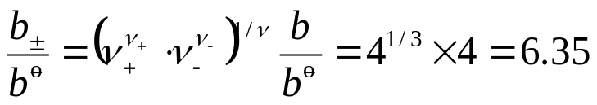
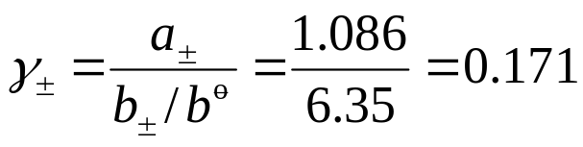
17.7 Electrochemical-Equilibrium Calculations
4. Calculations of Mean Ionic Activity Factors
Pt|H₂( )|H₂SO₄(4mol.kg⁻¹)| Hg₂SO₄(s)|Hg(l)
(2) Calculate the mean activity coefficient of H₂SO₄ solution
For H2SO4

Slide 14
16. Electrolyte Solutions
I. Electrochemical Equilibria
    17.2 Electromotive Force of Galvanic Cell and Interfacial
    Potential Difference
    17.3 Thermodynamics of Electrochemical Systems
    17.4 Potential and Standard Potential of Cell Reaction
    17.5 Potential and Standard Potential of Electrode Reaction
    17.6 Various Types of Electrodes and Standard Cell
    17.7 Electrochemical-Equilibrium Calculations
    17.8 Concentration Cell and Liquid-Junction Potential

Slide 15
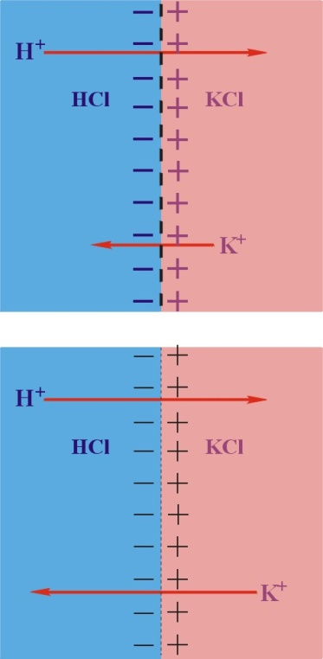
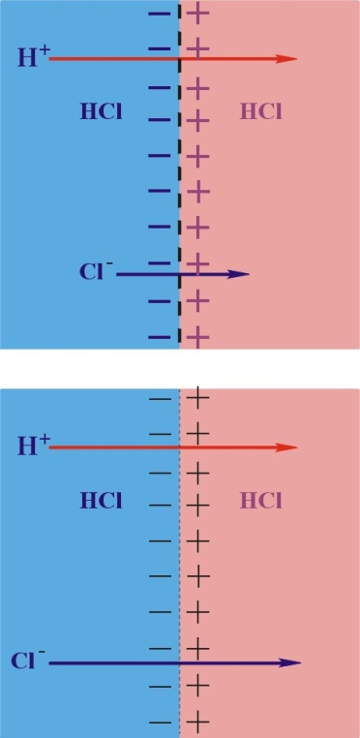
17.8 Concentration Cell and Liquid-Junction Potential
Concentration Cells
Their cell reaction is a transfer of substance from a higher concentration region to a lower one. Here the cell reaction is not a redox reaction. The total changes in the cell are physical changes
Different electrolytes
Different concentrations
Non-equilibrium
Equilibrium

Slide 16



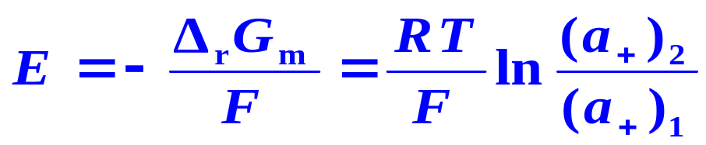

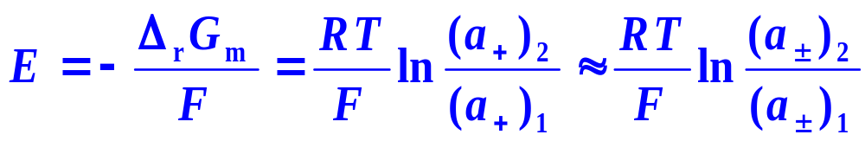
    17.8 Concentration Cell and Liquid-Junction Potential
2. Solution Concentration Cells
-）Ag │AgNO₃[(a₊)₁] AgNO₃[(a₊)₂] │Ag (+
Positive
Negative
Cell reaction
(a₊)₁< (a₊)₂

Slide 17
II. Theories of Electrode
- Solution Interface
Bilingual Program
版权所有：华东理工大学物理化学教研室

Slide 18
17. Electrochemistry
II. Theories of Electrode-Solution Interface
17.9 Outer Potential, Surface Potential and Inner Potential
17.10 Surface Excess Charge and Double-Layer Capacitance
17.11 Electric Double-Layer Models and Outer Potential
17.12 Absolute Potential of Electrode reaction

Slide 19
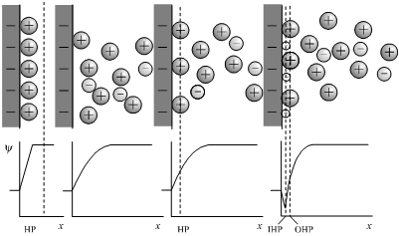
17.11 Electric Double-Layer Models and Outer Potential
+
+
+
+
+
+
Electric Double-Layer Models
+
+
+
-
+
+
+
-
-
+
-
+
+
+
+
+
+
-
+
-
+
+
-
+
-
+
-
-
+
+
+
-
+
+
+
+
+
-
Outer Potential
(a)
(b)
(c)
(d)
(a) Helmholtz model, (b) Gouy-Chapman model, (c) Stern mode，(d) Stern-Grahame mode

Slide 20
III. Electrochemical Kinetics
Bilingual Program
版权所有：华东理工大学物理化学教研室

Slide 21
17. Electrochemistry
III. Electrochemical Kinetics
17.13 Relations among Reaction Rate, Current and Potential
17.14 Polarization Phenomena and Over-Potential
17.15 Examples of Application
17.16 Transition-State Theory of Electrode

Slide 22
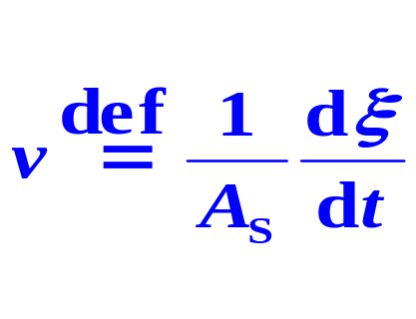

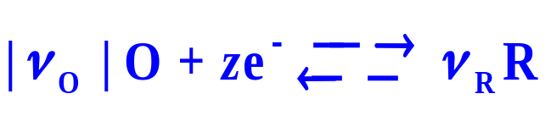


17.13 Relations among Reaction Rate, Current and Potential
1. Rate and Current of Electrode Reaction
Rate of Electrode Reaction
mol⋅m⁻² ⋅s⁻¹
The variation rate of the reaction extent with time in a unit electrode-solution interface.
Rate of Cell Reaction
Because of the different areas for the cathode and the anode, the rate of conversion is adopted.
Positive or Negative Sign of Current
The current entering the solution from the electrode is positive, and the contrary is negative.
Partial Cathodic Current
Partial Anodic Current

Slide 23

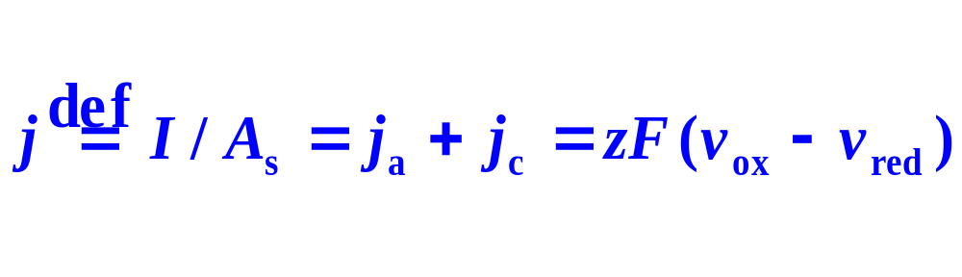
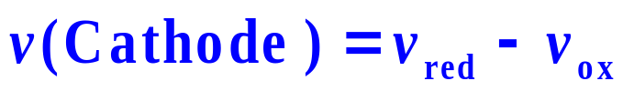
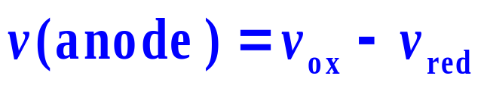
17.13 Relations among Reaction Rate, Current and Potential
Current and Current Density
j_{c}— Partial cathodic current density,
j_{a}— Partial anodic current density
Rate Equation of Electrode Reaction

Slide 24
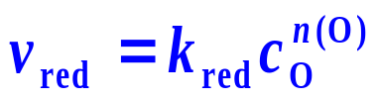
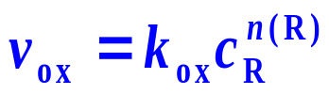
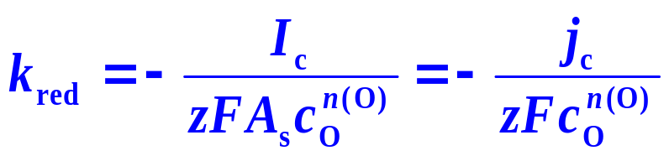
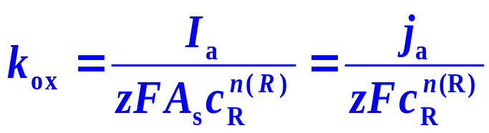
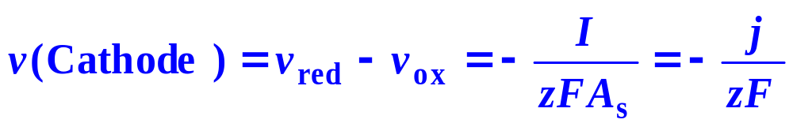
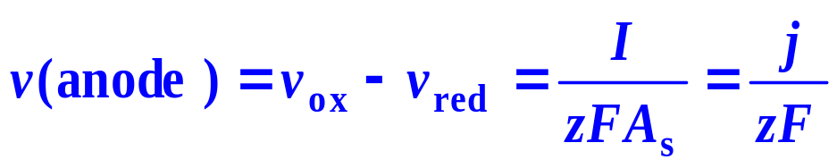
17.13 Relations among Reaction Rate, Current and Potential
Rate Equation of Electrode Reaction

Slide 25
17. Electrochemistry
III. Electrochemical Kinetics
17.13 Relations among Reaction Rate, Current and Potential
17.14 Polarization Phenomena and Over-Potential
17.15 Examples of Application
17.16 Transition-State Theory of Electrode

Slide 26
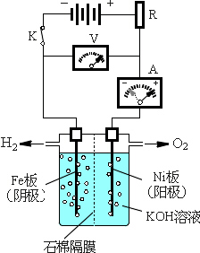
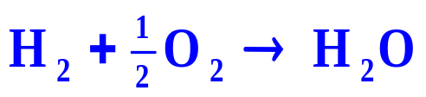
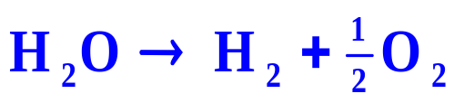
17.14 Polarization Phenomena and Over-Potential
Irreversible Processes
Whatever in a galvanic cell or an electrolytic cell, there is a certain current passing through during working, therefore, the processes are all irreversible.
The galvanic cell proceeded in a reversible condition is an ideal standard for realizing an electrochemical process.
E_{ext}
A galvanic cell
E_{ext} = E_{cell} － dE
An electrolytic cell
E_{ext} = E_{cell} + dE

Slide 27

17.14 Polarization Phenomena and Over-Potential
Polarization Phenomena
The phenomena concerning notable difference between the real electrode potential and the potential of electrode reaction.
Over-Potential
η
The difference between the real electrode potential and the potential of electrode reaction,
Polarizable Electrodes
The electrodes with polarization phenomena accompanied.
Non-Polarizable Electrodes
The electrodes with negligible polarization phenomena.

Slide 28
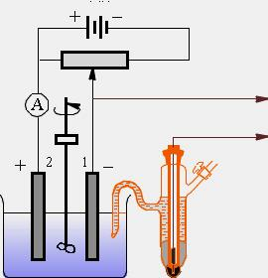
17.14 Polarization Phenomena and Over-Potential
1. Determination of Over-Potential
Power
Resistance
Stirrer
Potential meter
Calomel electrode

Slide 29


17.14 Polarization Phenomena and Over-Potential
Galvanic cell
Electrolytic cell
anodic curve
cathodic curve
cathodic curve
anodic curve
j
E_{a}(0)+η_{a}- E_{c}(0)- η_{c}
E_{c}(0)+ η_{c}-E_{a}(0)-η_{a}-
η_{a}
η_{c}
η_{c}
η_{a}
E_{a}(0)
E
E_{c}(0)
E_{c}(0)
E_{a}(0)
E

Slide 30




17.14 Polarization Phenomena and Over-Potential
Galvanic cell
Electrolytic cell
anodic curve
cathodic curve
cathodic curve
anodic curve
j
E_{a}(0)+η_{a}- E_{c}(0)- η_{c}
E_{c}(0)+ η_{c}-E_{a}(0)-η_{a}-
η_{a}
η_{c}
η_{c}
η_{a}
E_{a}(0)
E
E_{c}(0)
E_{c}(0)
E_{a}(0)
E

Slide 31
17.14 Polarization Phenomena and Over-Potential
Example Using Zn as the cathode to electrolyze a neutral aqueous solution of ZnSO₄ with a concentration of 0.1mol⋅kg⁻¹, the current density is 10mA⋅cm⁻². What substance will be separated out, Zn or H₂? (the solution is kept as neutral.

Slide 32



17.14 Polarization Phenomena and Over-Potential
Solution: The potential of electrode reaction of
where γ₊=1 is supposed. Because the over-potential of the metal-metal ion electrode is very small that can be neglected, this E is the electrode potential of

Slide 33



17.14 Polarization Phenomena and Over-Potential
If H₂ is formed, the electrode is
the potential of electrode reaction is:
The potential is higher, that H⁺ seems to be easier than Zn²⁺ to be reduced.

Slide 34

17.14 Polarization Phenomena and Over-Potential
when j=10mA⋅cm⁻², the over-potential of H₂ on Zn electrode is:
η_{c}=-0.746V. Therefore, the electrode potential is:
The potential is lower than the electrode potential of
H⁺ is harder than Zn²⁺ to be reduced. In the condition of the example, Zn should be separated out.
With the proceeding of electrolysis, the concentration of Zn²⁺ depresses continuously, the electrode potential of
drops as well. When it reaches –1.160V, H₂ will be separated out simultaneously with Zn.

Slide 35

17.14 Polarization Phenomena and Over-Potential
2. Activation Over-Potential
Definition
The over-potential affects the activation-energy barrier of the electrode reaction directly. At lower current density are primarily the activation over-potential.
Tafel Equation
For most metal electrodes b ~ 0.10 - 0.14 V
The larger a is, the higher over-potential will be.
The relation between the activation over-potential of hydrogen separated out on the metal electrode with the current density

Slide 36


17.14 Polarization Phenomena and Over-Potential
3. Mass Transfer Over-Potential
Ionic Diffusion
A linear diffusion in Nernst diffusion layer with a thickness of δ
Oxidation reaction carries out on the anode with the negative charges flowing from the solution to the electrode

Slide 37


17.14 Polarization Phenomena and Over-Potential
Concentration Polarization
For anions with oxidation reaction on the anode, the over-potential obtained is η_{a}
z<0
Limiting Current Density
As η_{a} continuously enhances, c_{B0} will approach zero
where j_{L} is the limiting current density of the anode dependent on the bulk concentration only.

Slide 38
17. Electrochemistry
III. Electrochemical Kinetics
17.13 Relations among Reaction Rate, Current and Potential
17.14 Polarization Phenomena and Over-Potential
17.15 Examples of Application
17.16 Transition-State Theory of Electrode

Slide 39
Framework of the Chapter
Electrochemistry
Electrochemical Equilibria
Theories of Electrode
Solution Interface
Electrochemical Kinetics
Electromotive
Force
Outer Potential
Surface Potential
Inner Potential
Potential Relations among Reaction Rate, Current and Potential
电化学系统
的热力学
Thermodynamics
Surface Excess Charge Double-Layer Capacitance
Potential of
Cell Reaction
Polarization Phenomena Over-Potential
Potential of
Electrode Reaction
Electric Double-Layer Models
Outer Potential
Applications
Various Types
of Electrodes
Absolute Potential of Electrode Reaction
Transition-State Theory of Electrode Reactions
Calculations
Concentration Cell
Liquid-Junction Potential

